Slide 1

Introduction to Python
3
Presented by : Ramesh Pradhan
Designation : Senior Software Engineer
This Photo by Unknown Author is licensed under CC BY-SA

Slide 2
So what is Python ?
Notes:
Notes to presenter:
What is your purpose for sharing this reflection?
Is it at the end of a unit or project?
Are you sharing this reflection, at the attainment of a learning goal you set for yourself?
Is it at the end of a course?
State your purpose for the reflection or even the purpose of the learning experience or learning goal. Be clear and be specific in stating your purpose.

Slide 3
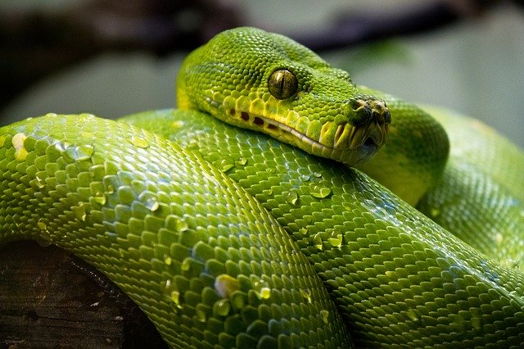

<1991
2025
This Photo by Unknown Author is licensed under CC BY-SA-NC

Slide 4

What is Python?
an interpreted, high-level, general purpose programming language to talk to machine
dynamically typed and garbage-collected.
Is with "batteries included"
Guido Van Rossum
Notes:
Notes to presenter:
Description of what you learned in your own words on one side.
Include information about the topic
Details about the topic will also be helpful here.
Tell the story of your learning experience. Just like a story there should always be a beginning, middle and an end.
On the other side, you can add a graphic that provides evidence of what you learned.
Feel free to use more than one slide to reflect upon your process. It also helps to add some video of your process.

Slide 5
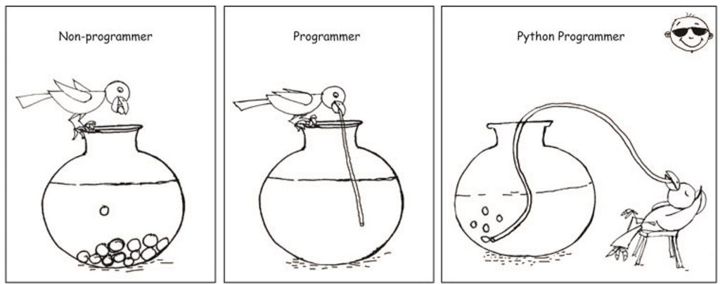
Why learn Python?
Notes:
Notes to presenter:
Description of what you learned in your own words on one side.
Include information about the topic
Details about the topic will also be helpful here.
Tell the story of your learning experience. Just like a story there should always be a beginning, middle and an end.
On the other side, you can add a graphic that provides evidence of what you learned.
Feel free to use more than one slide to reflect upon your process. It also helps to add some video of your process.

Slide 6
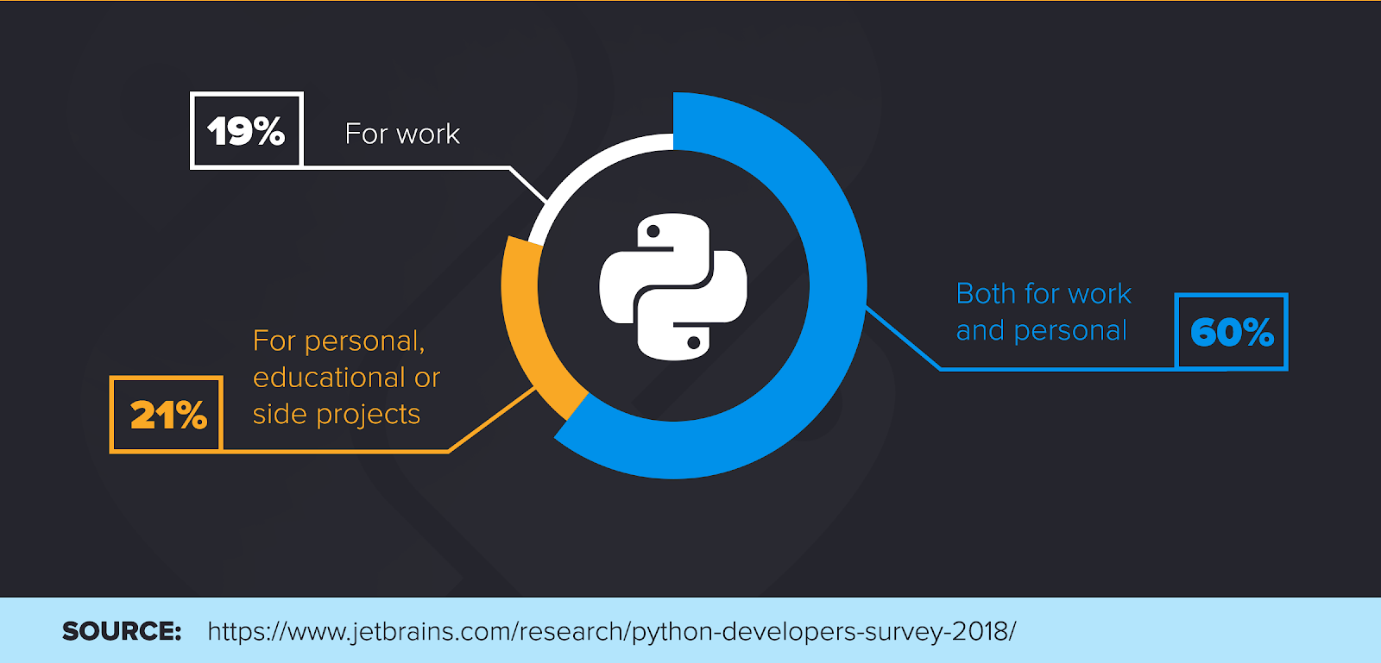
And why learn now?
Notes:
Notes to presenter:
Description of what you learned in your own words on one side.
Include information about the topic
Details about the topic will also be helpful here.
Tell the story of your learning experience. Just like a story there should always be a beginning, middle and an end.
On the other side, you can add a graphic that provides evidence of what you learned.
Feel free to use more than one slide to reflect upon your process. It also helps to add some video of your process.

Slide 7

And why learn now? Cont..
Notes:
Notes to presenter:
Description of what you learned in your own words on one side.
Include information about the topic
Details about the topic will also be helpful here.
Tell the story of your learning experience. Just like a story there should always be a beginning, middle and an end.
On the other side, you can add a graphic that provides evidence of what you learned.
Feel free to use more than one slide to reflect upon your process. It also helps to add some video of your process.

Slide 8
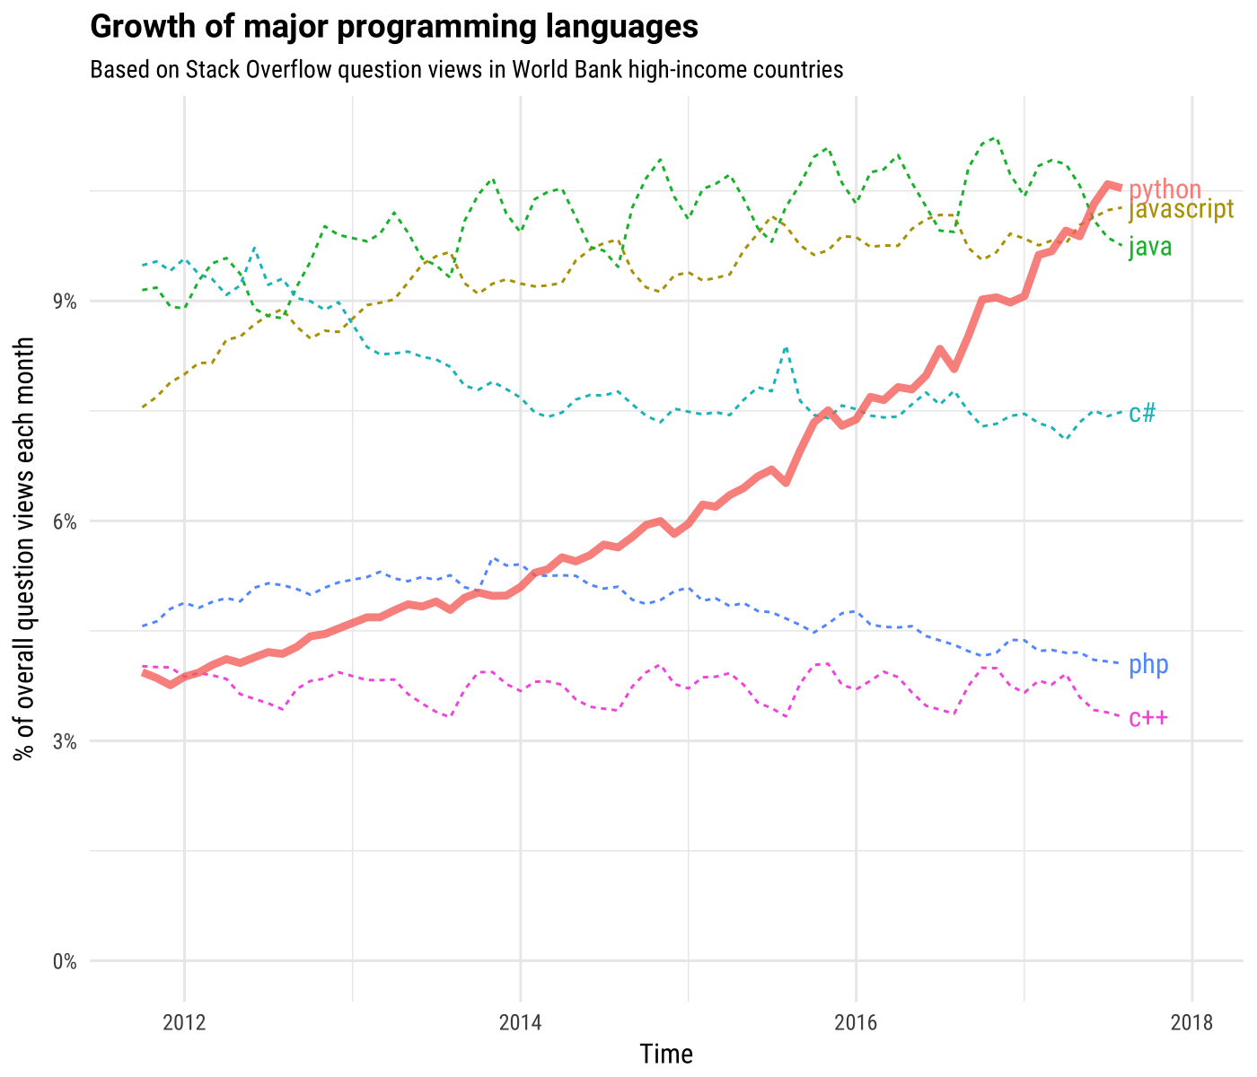
And why learn now? Cont..
Notes:
Notes to presenter:
Description of what you learned in your own words on one side.
Include information about the topic
Details about the topic will also be helpful here.
Tell the story of your learning experience. Just like a story there should always be a beginning, middle and an end.
On the other side, you can add a graphic that provides evidence of what you learned.
Feel free to use more than one slide to reflect upon your process. It also helps to add some video of your process.

Slide 9
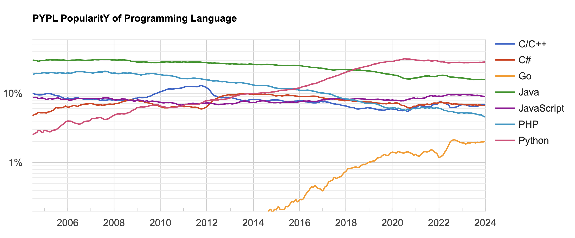
And why learn now? Cont..
Source: https://pypl.github.io/PYPL.html
Notes:
Notes to presenter:
Description of what you learned in your own words on one side.
Include information about the topic
Details about the topic will also be helpful here.
Tell the story of your learning experience. Just like a story there should always be a beginning, middle and an end.
On the other side, you can add a graphic that provides evidence of what you learned.
Feel free to use more than one slide to reflect upon your process. It also helps to add some video of your process.

Slide 10
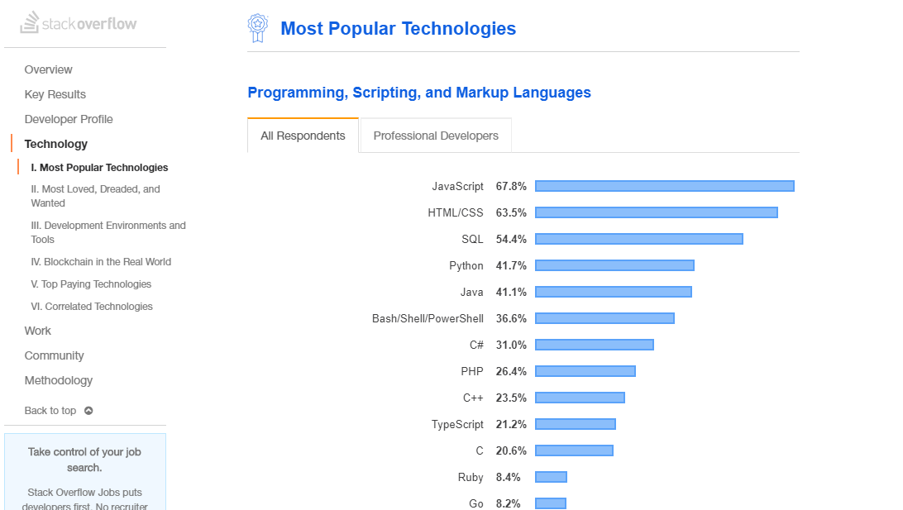
And why learn now? Cont..
https://insights.stackoverflow.com/survey/2019#technology
Notes:
Notes to presenter:
Description of what you learned in your own words on one side.
Include information about the topic
Details about the topic will also be helpful here.
Tell the story of your learning experience. Just like a story there should always be a beginning, middle and an end.
On the other side, you can add a graphic that provides evidence of what you learned.
Feel free to use more than one slide to reflect upon your process. It also helps to add some video of your process.

Slide 11
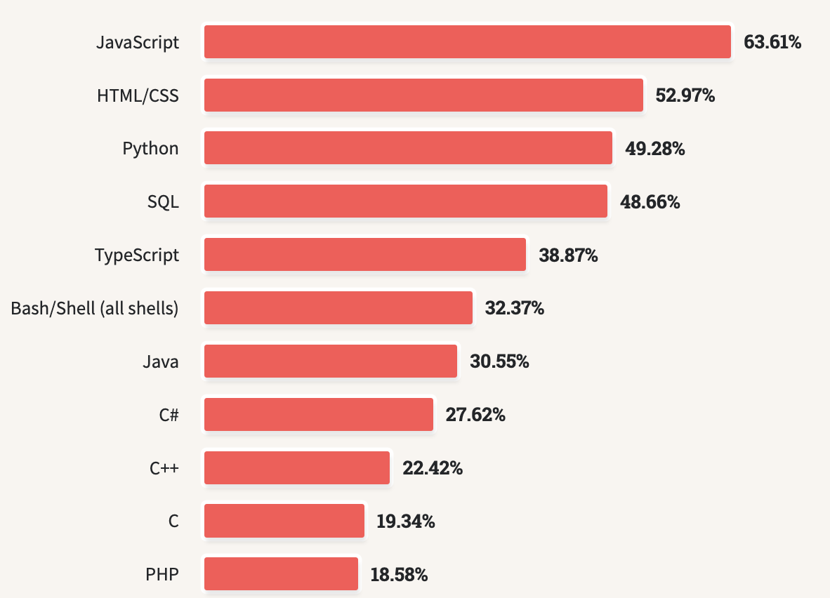
And why learn now? Cont..
https://survey.stackoverflow.co/2023/#technology-most-popular-technologies
Notes:
Notes to presenter:
Description of what you learned in your own words on one side.
Include information about the topic
Details about the topic will also be helpful here.
Tell the story of your learning experience. Just like a story there should always be a beginning, middle and an end.
On the other side, you can add a graphic that provides evidence of what you learned.
Feel free to use more than one slide to reflect upon your process. It also helps to add some video of your process.

Slide 12
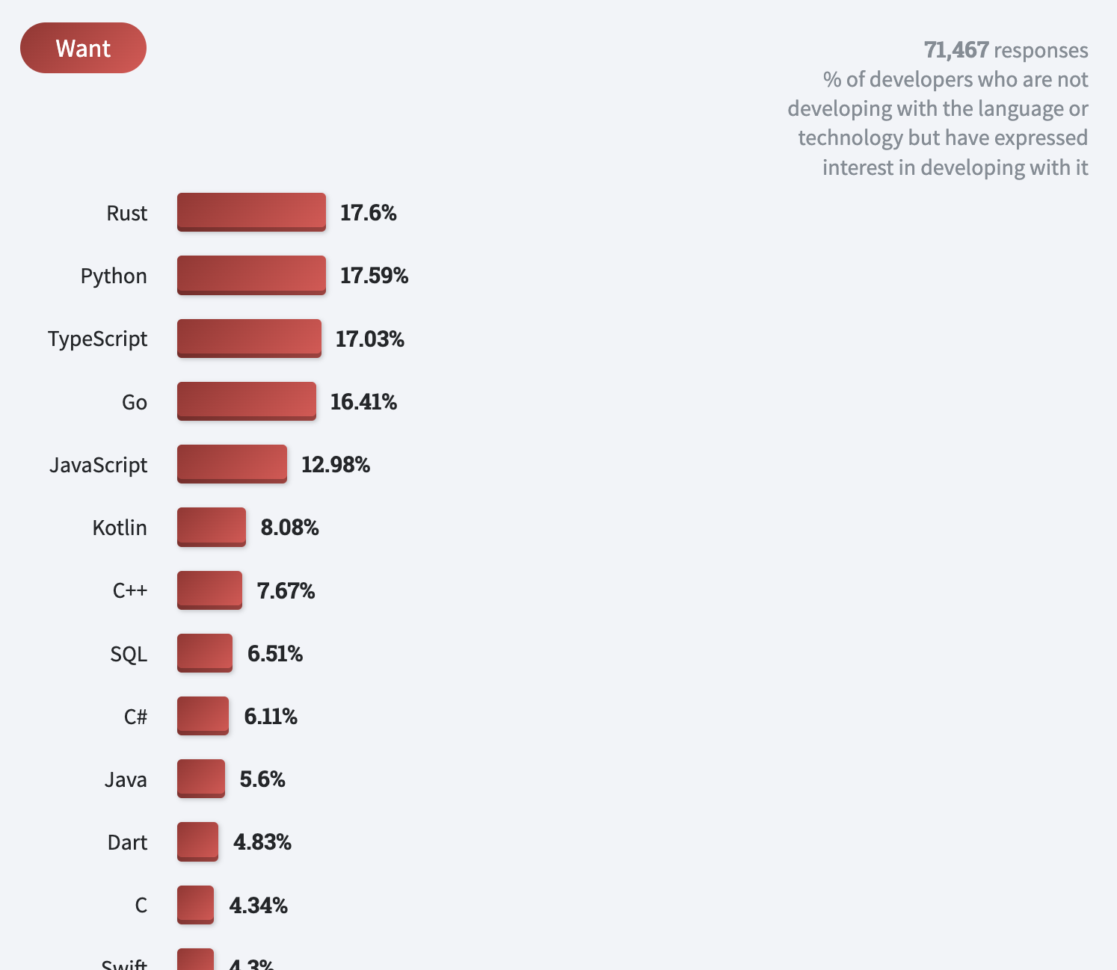
And why learn now? Cont..
https://survey.stackoverflow.co/2022/#most-loved-dreaded-and-wanted-language-want
Notes:
Notes to presenter:
Description of what you learned in your own words on one side.
Include information about the topic
Details about the topic will also be helpful here.
Tell the story of your learning experience. Just like a story there should always be a beginning, middle and an end.
On the other side, you can add a graphic that provides evidence of what you learned.
Feel free to use more than one slide to reflect upon your process. It also helps to add some video of your process.

Slide 13

And why learn now? Cont..
Notes:
Notes to presenter:
Description of what you learned in your own words on one side.
Include information about the topic
Details about the topic will also be helpful here.
Tell the story of your learning experience. Just like a story there should always be a beginning, middle and an end.
On the other side, you can add a graphic that provides evidence of what you learned.
Feel free to use more than one slide to reflect upon your process. It also helps to add some video of your process.

Slide 14
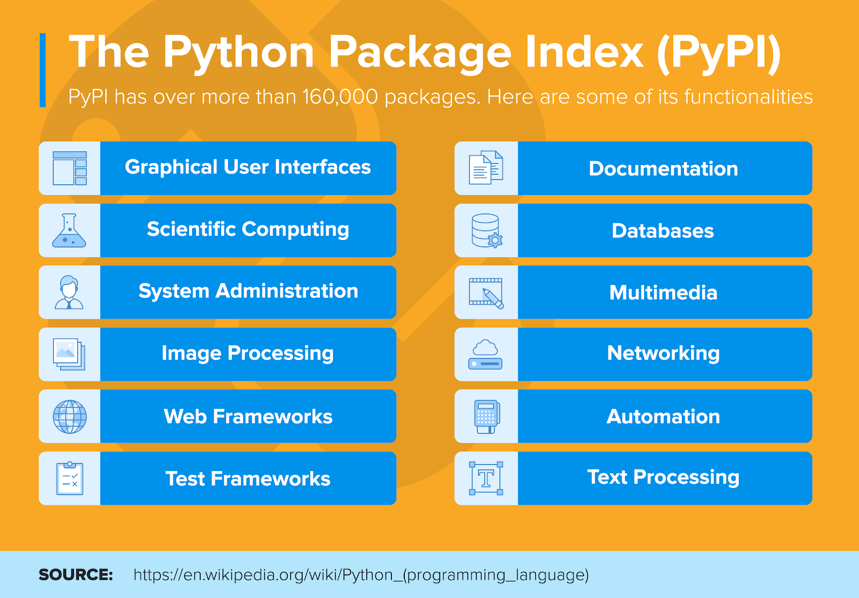
What can I do with Python?
Notes:
Notes to presenter:
Description of what you learned in your own words on one side.
Include information about the topic
Details about the topic will also be helpful here.
Tell the story of your learning experience. Just like a story there should always be a beginning, middle and an end.
On the other side, you can add a graphic that provides evidence of what you learned.
Feel free to use more than one slide to reflect upon your process. It also helps to add some video of your process.

Slide 15
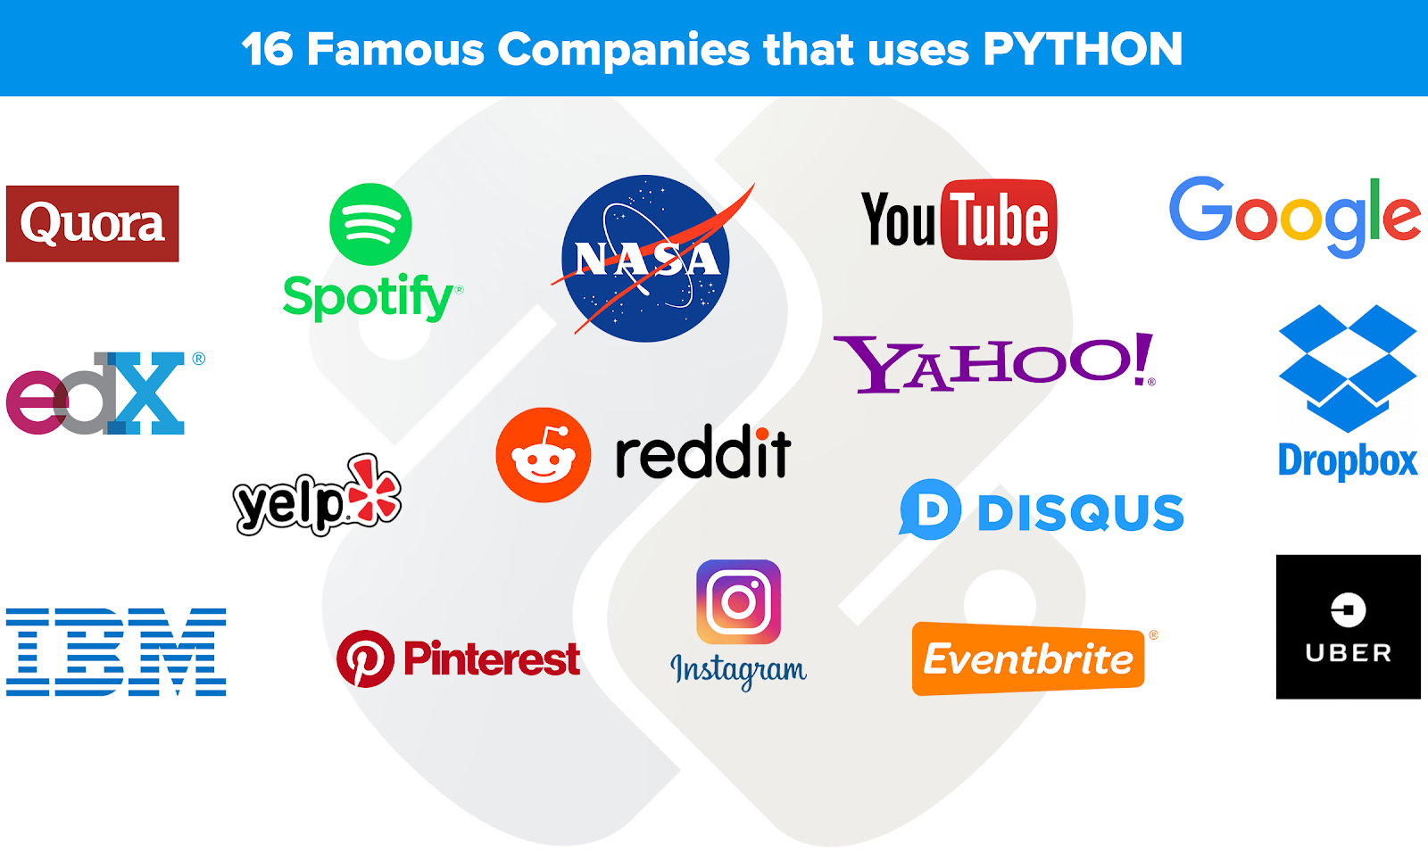
Who uses python ?
Notes:
Notes to presenter:
Description of what you learned in your own words on one side.
Include information about the topic
Details about the topic will also be helpful here.
Tell the story of your learning experience. Just like a story there should always be a beginning, middle and an end.
On the other side, you can add a graphic that provides evidence of what you learned.
Feel free to use more than one slide to reflect upon your process. It also helps to add some video of your process.

Slide 16

Python Technical Strength(Features)
Easy to CODE
Easy to READ
Free and Open Source
Object-Oriented Language
Large Standard Library
GUI Programming Support
Cross-platform Language
Very Powerful
Extensible
Interpreted Language
Extensible
Expressive
Dynamically Typed
Databases Connectivity…
Notes:
Notes to presenter:
Description of what you learned in your own words on one side.
Include information about the topic
Details about the topic will also be helpful here.
Tell the story of your learning experience. Just like a story there should always be a beginning, middle and an end.
On the other side, you can add a graphic that provides evidence of what you learned.
Feel free to use more than one slide to reflect upon your process. It also helps to add some video of your process.

Slide 17
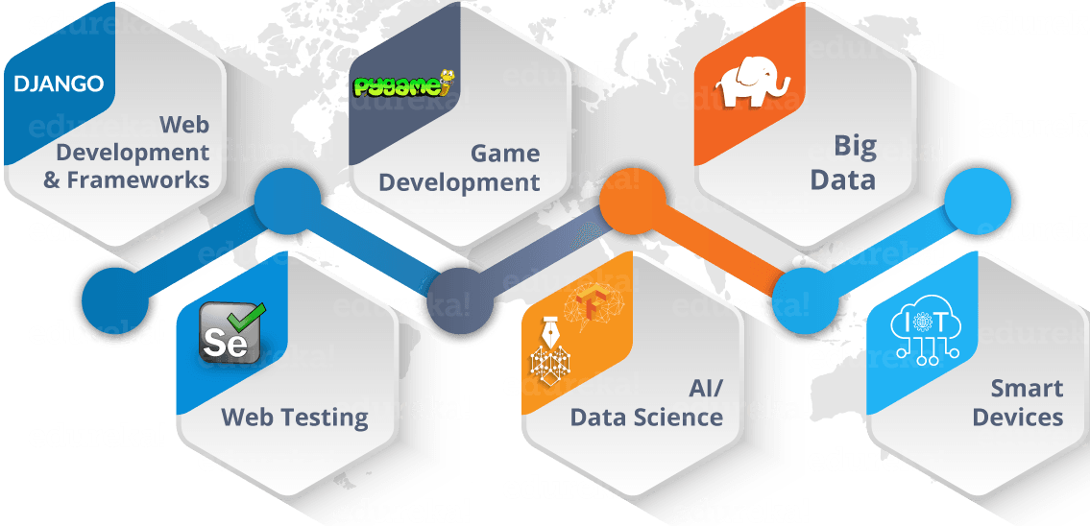
What after learning python?
…
Notes:
Notes to presenter:
Description of what you learned in your own words on one side.
Include information about the topic
Details about the topic will also be helpful here.
Tell the story of your learning experience. Just like a story there should always be a beginning, middle and an end.
On the other side, you can add a graphic that provides evidence of what you learned.
Feel free to use more than one slide to reflect upon your process. It also helps to add some video of your process.

Slide 18


What are your next steps?
Practice coding with python
4
Think an idea for your next project
3
2
Try to solve small piece at time
1
Finish your project goal
Notes:
Notes to presenter:
What steps will you be taking as a result of this learning experience?
Did you learn from any failed experiences? How will you do things differently?
What advice will you give to others so they can learn from your experiences?
How can you share what you learned with a real-world audience?
Some examples of next steps might be:
After delivering my first persuasive presentation, I am thinking about joining the debate team.
After making my first film, I’m considering entering it in our school film festival or local film festival.
After connecting with this career expert, I’d like to do some research on that career field because it sounds interesting to me.
This SmartArt allows you add images and text to help outline your process. If a picture is worth a thousand words, then pictures and words should help you communicate this reflection on learning perfectly! You can always click on Insert>SmartArt to change this graphic or select the graphic and click on the Design contextual menu to change the colors.
Feel free to use more than one slide to share your next steps. It also helps to add some video content to explain your message.

Slide 19
Thank you
This Photo by Unknown Author is licensed under CC BY-SA

